Slide 1
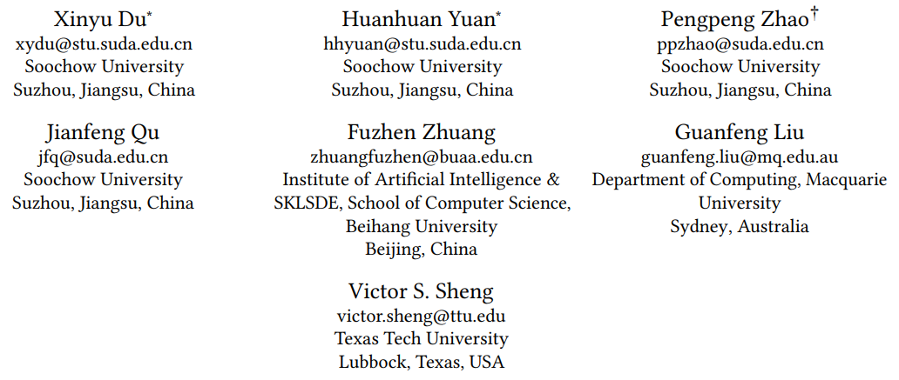
Chongqing University of Technology
ATAI
Advanced Technique of Artificial Intelligence
Chongqing University of Technology
Frequency Enhanced Hybrid Attention Network for Sequential
Recommendation
—— SIGIR 2023
2023.12.10 • ChongQing
Reported by Peng Shan

Slide 2
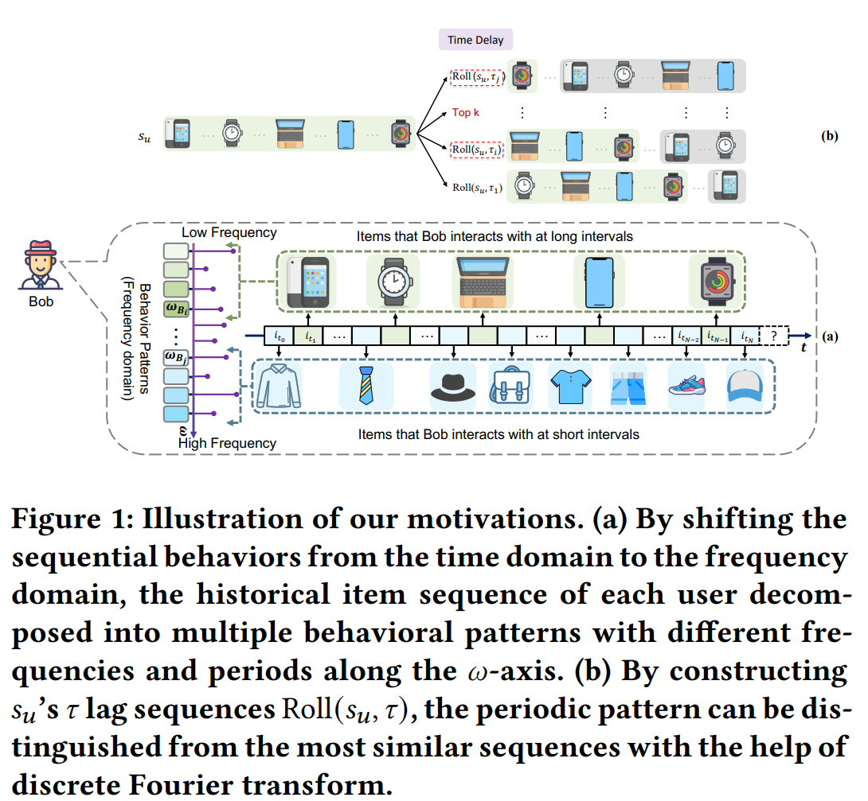
Motivation
（1）Self-attention used in current Transformer based models is constantly a low-pass filter, which continuously erases high-frequency information。The models almost process the historical interactions from the perspective of the time domain, but seldom consider tackling this challenge in the frequency domain。
（2）Moreover, users’ behaviors on the Internet tend to show certain periodic trends，it is difficult to find the periodic behavior patterns hidden in the sequence by directly calculating the overall attention scores of items in the time domain。

Slide 3
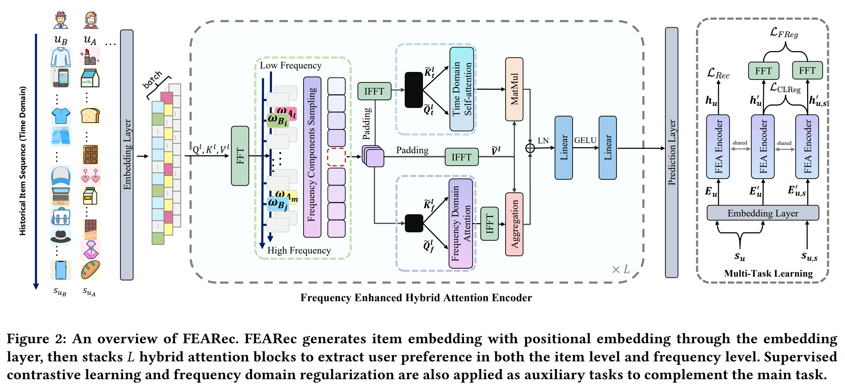
Method

Slide 4
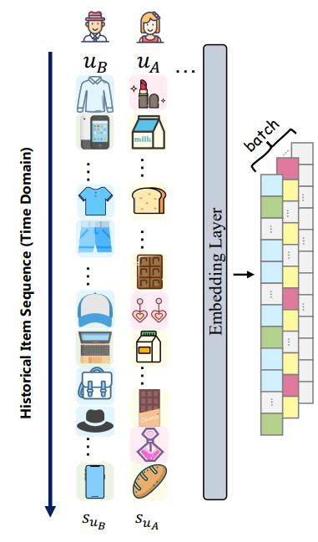
Method

Slide 5
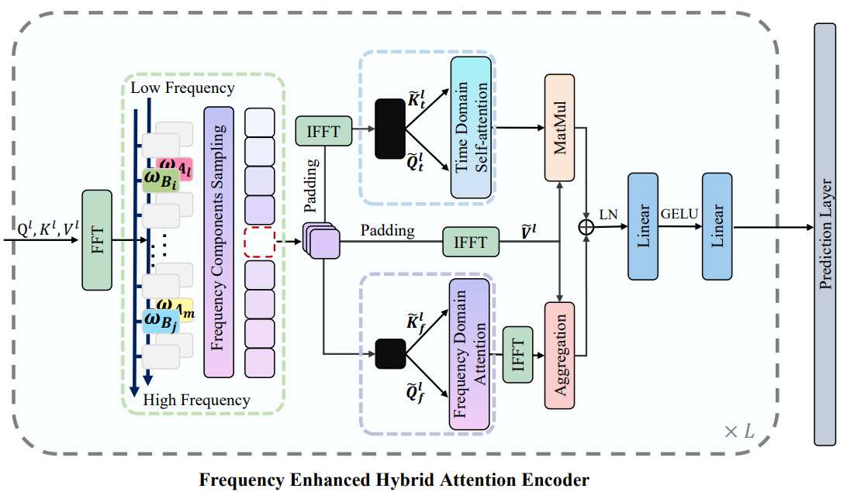
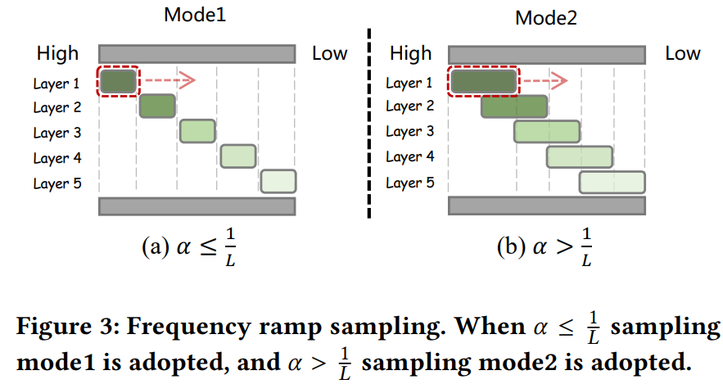
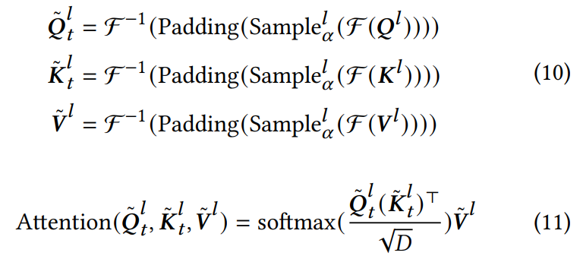
Method

Slide 6
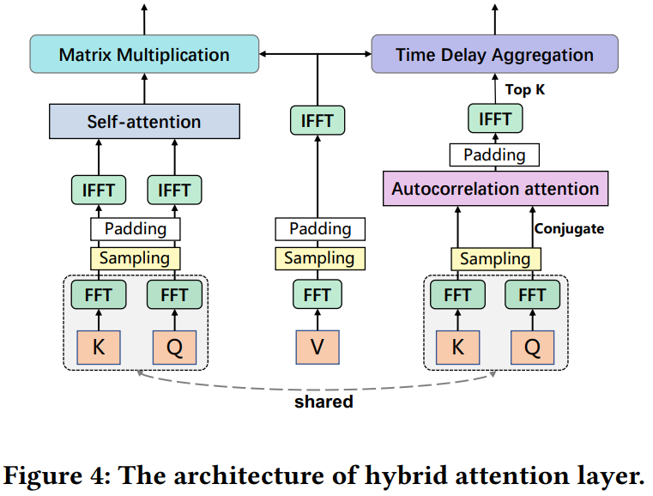
Method

Slide 7
Method

Slide 8
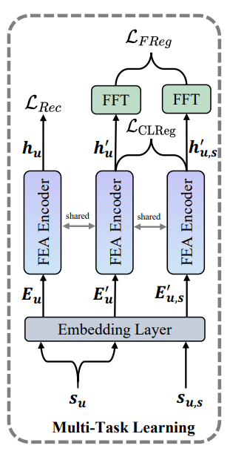
Method

Slide 9
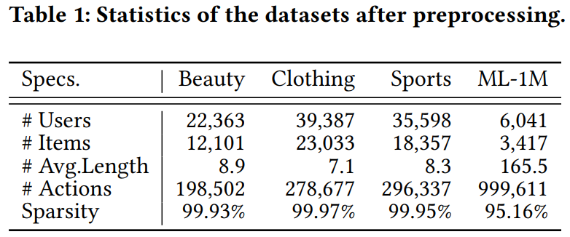
Experiments

Slide 10
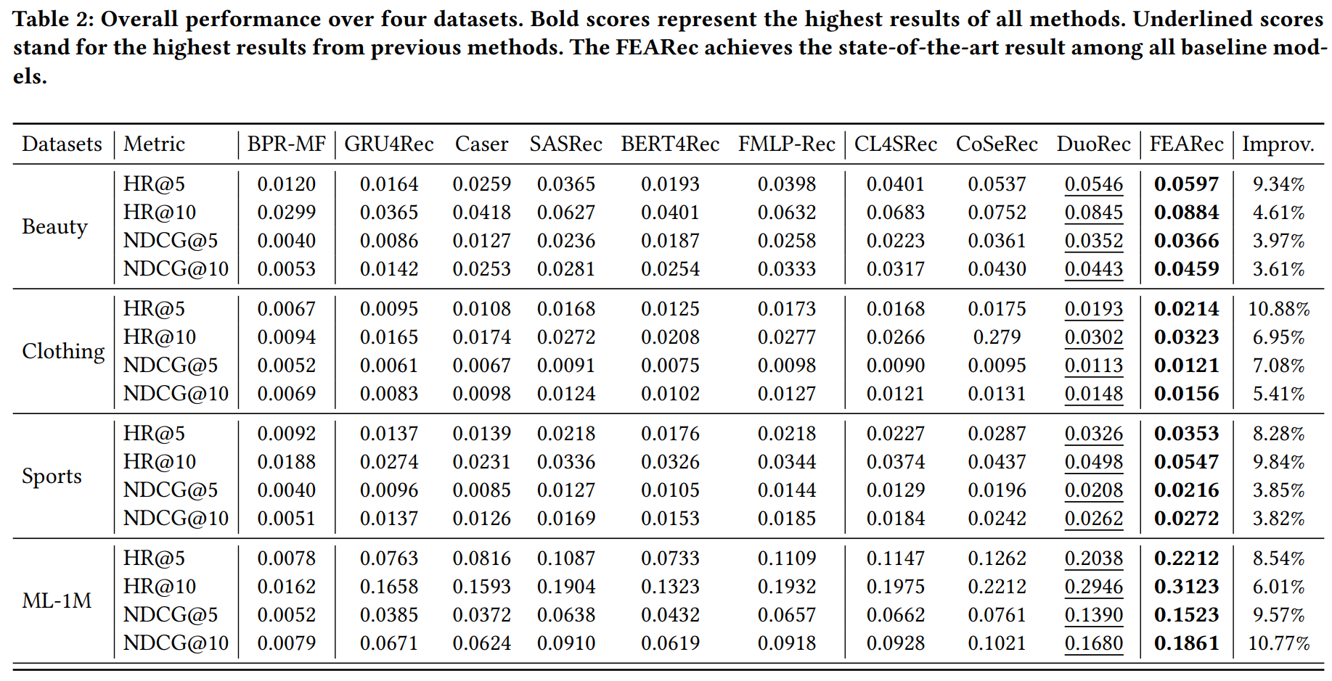
Experiments

Slide 11
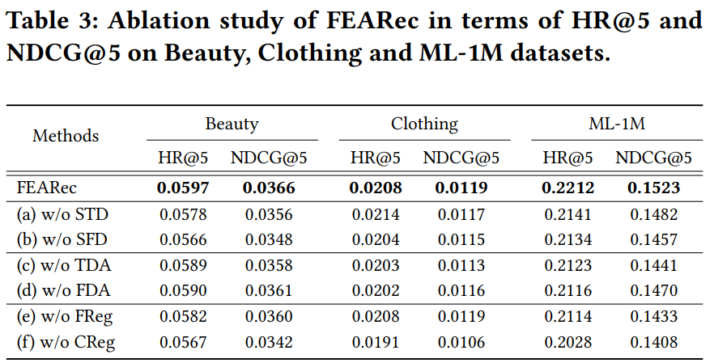
Experiments

Slide 12
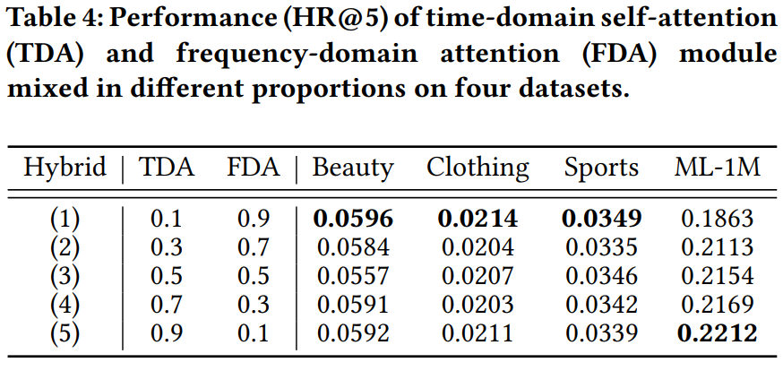
Experiments

Slide 13
Experiments

Slide 14
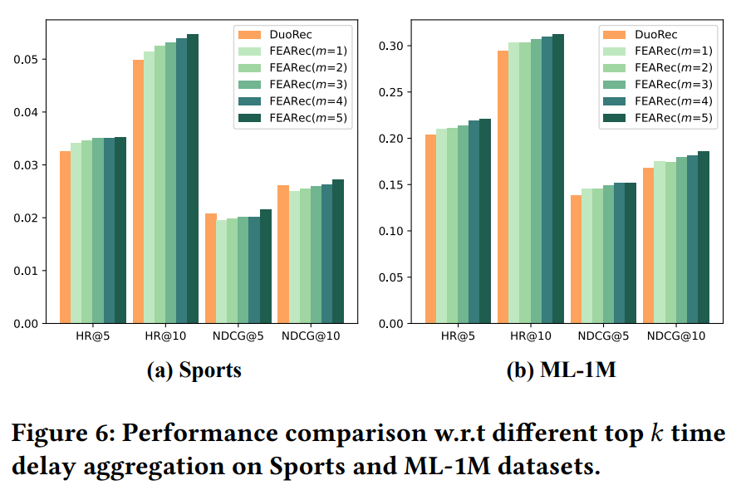
Experiments

Slide 15
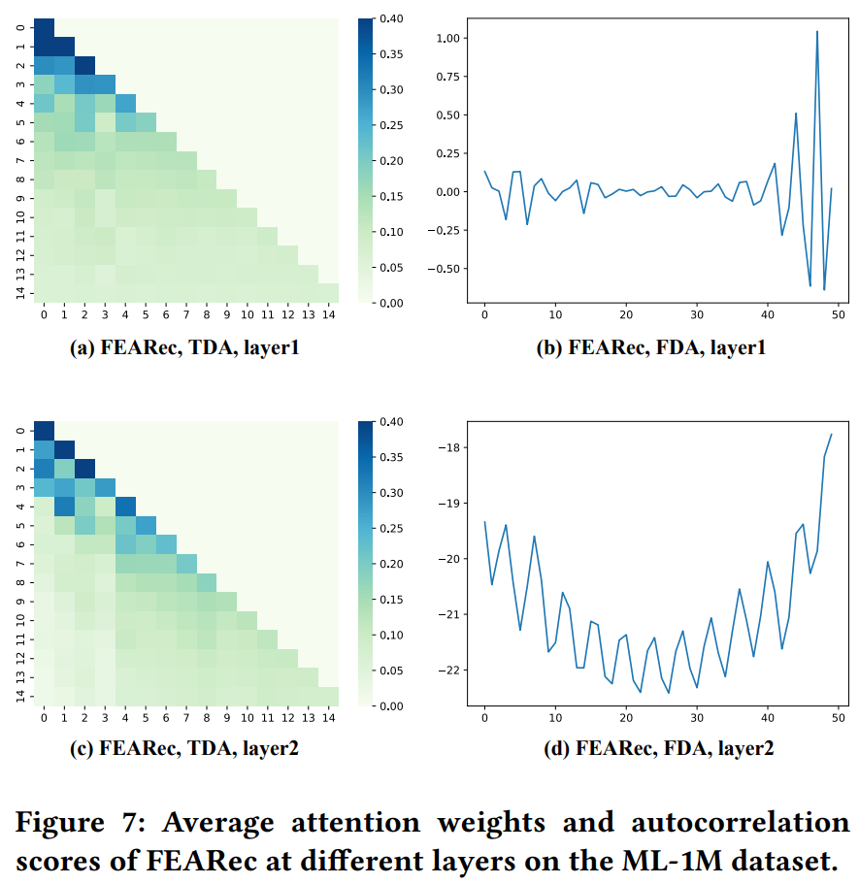
Experiments

Slide 16
Thanks!

